Slide 1
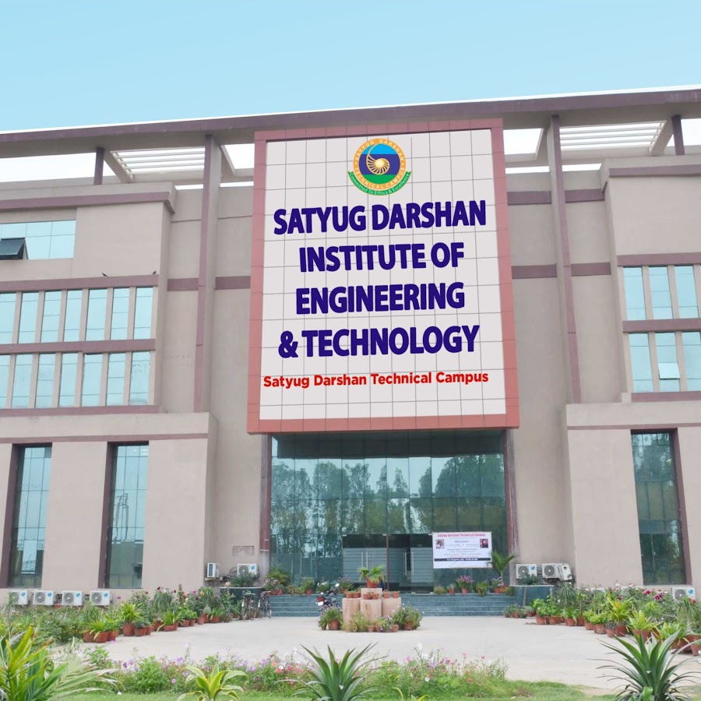

SDIET Management System
Presented by: Amandeep Singh
Roll No.: 19020004014
Submitted to: Nidhi Mam

Slide 2

References
Books:
* Let Us C (Yashavant Kanetkar)
* Programmimg For Problem Solving (Dr.S.Anandamurugan)
Internet Sources:
* https://www.geeksforgeeks.org/basics-file-handling-c/
* https://www.tutorialspoint.com/cprogramming/c_file_io.htm
* http://forums.codeblocks.org/index.php?topic=12119.0
Software Used
*Code::Blocks (20.03)
*Windows 10(64-bit)

Slide 3


In this project, I made a management system which take the records of the students in txt file to get admission in the college in various streams, in which we can add , modify, search, show all the records of the students. Also in this project you can take an overview of Satyug Darshan Institute Of Engineering And Technology College by choosing differnet menu options from the menu bar. Also if you want to edit your record there is a option ‘student information’ which is only for the college department for editing your record in case if you entered wrong details.
INTRODUCTION

Slide 4
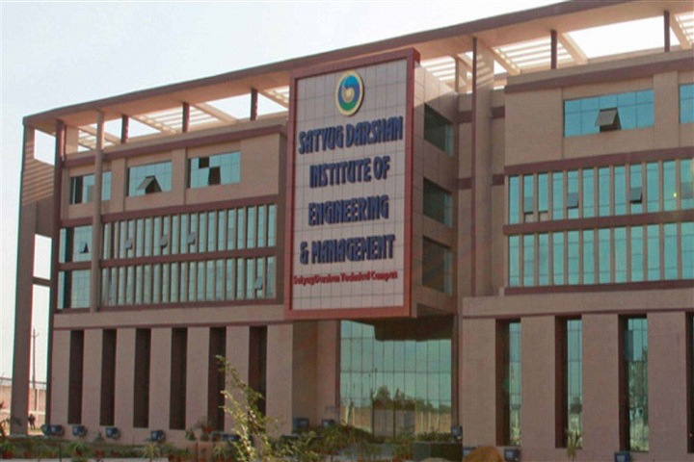
Output of the project code

Slide 5
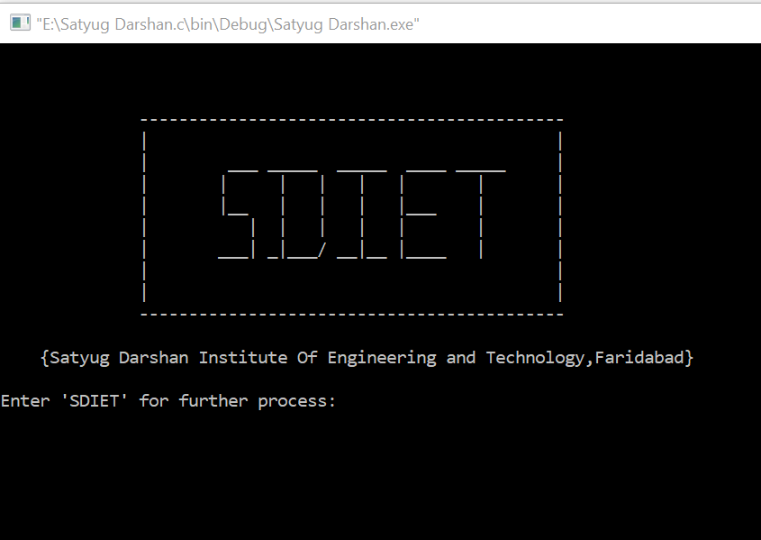
MAIN SCREEN

Slide 6
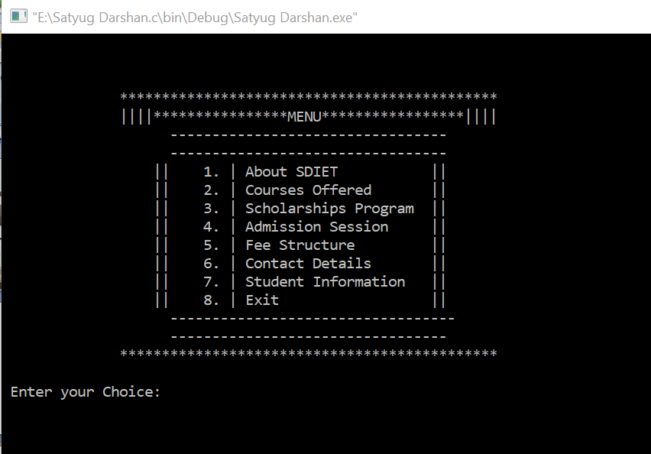
MENU SCREEN

Slide 7
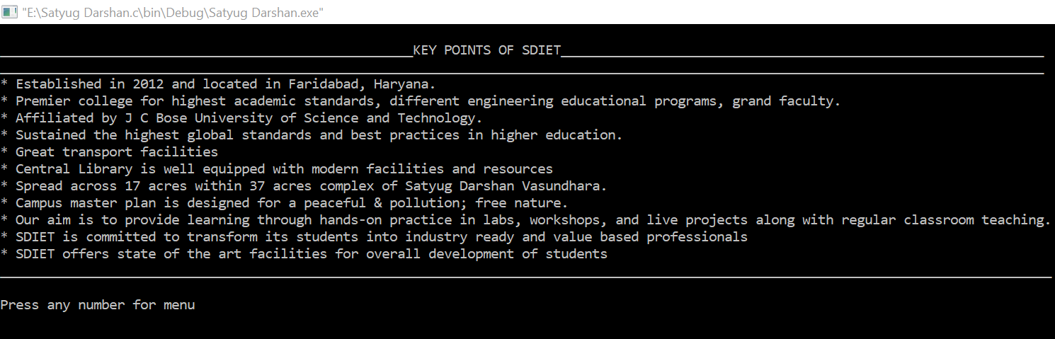
ABOUT SDIET

Slide 8
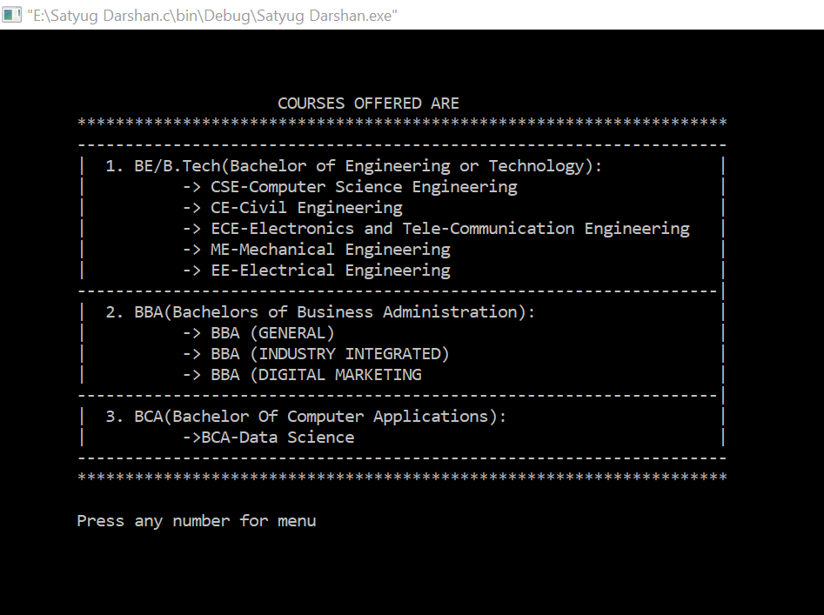
COURSES OFFERED

Slide 9
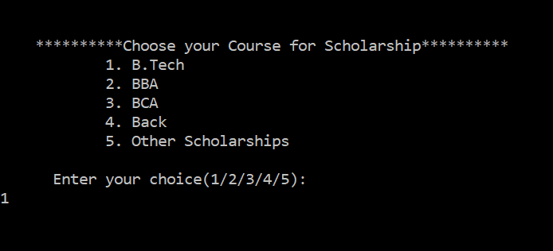
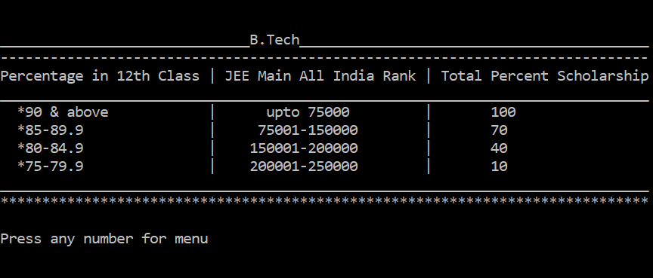
Scholarship
Program

Slide 10
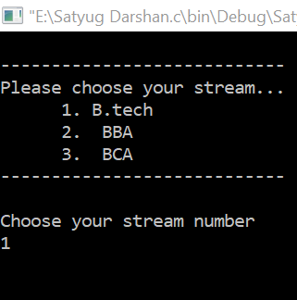
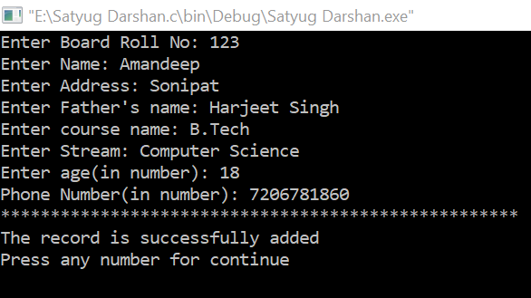
Admission
Session

Slide 11
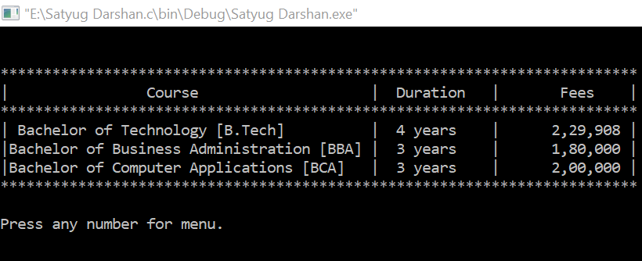
FEE STRUCTURE

Slide 12
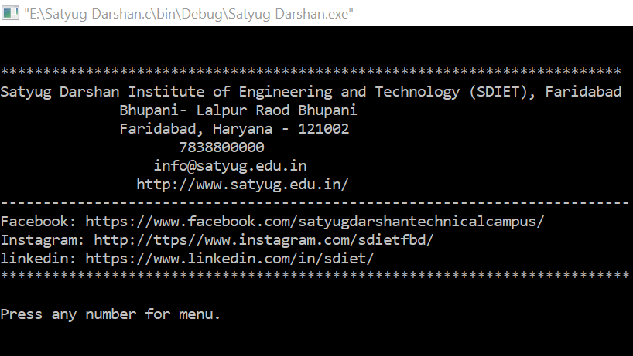
CONTACT DETAILS

Slide 13
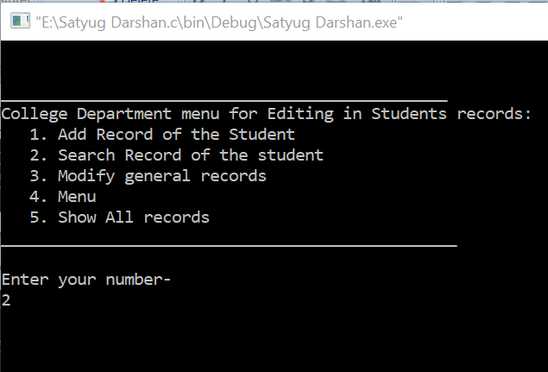
Student Information

Slide 14
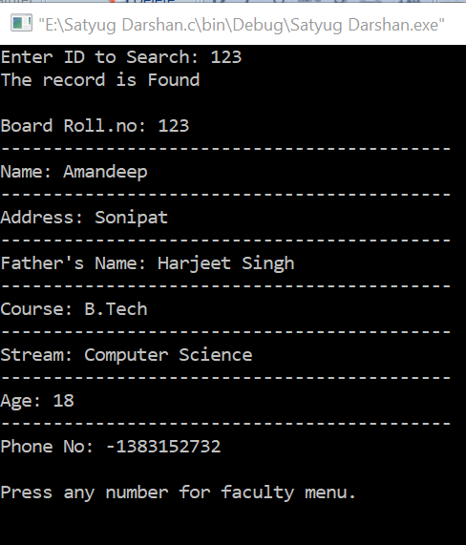
Search
The
Record

Slide 15
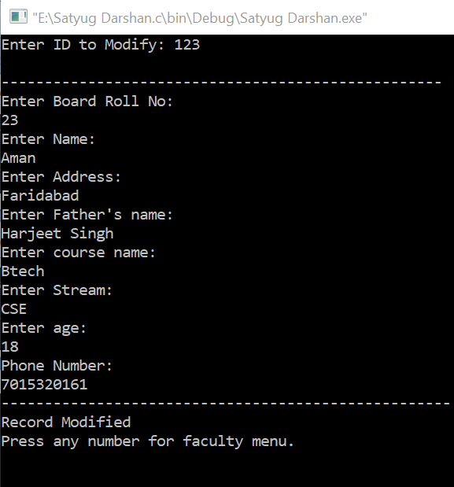
Modify
The
Record

Slide 16
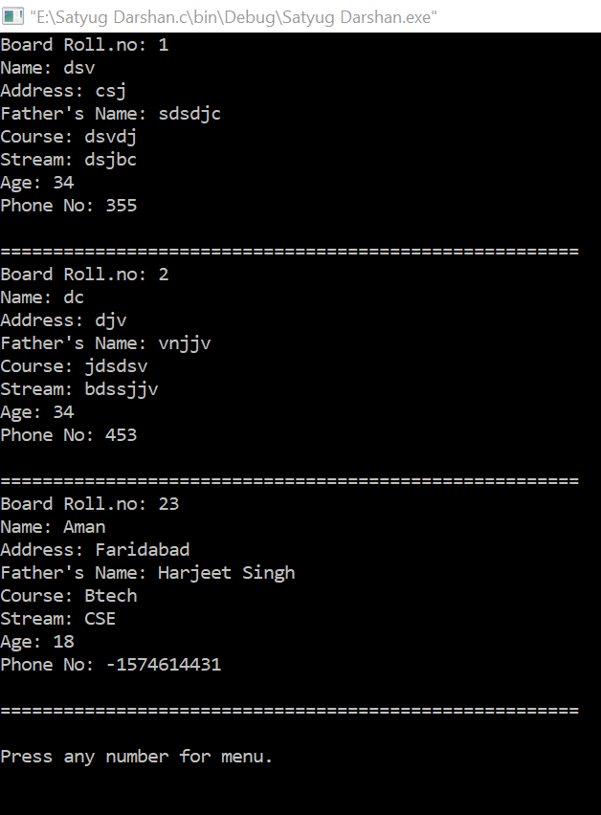
Show
All
Records

Slide 17
